Slide 1
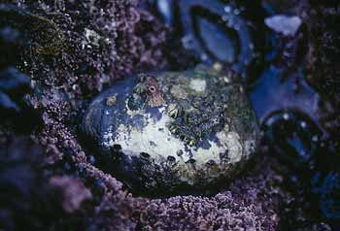
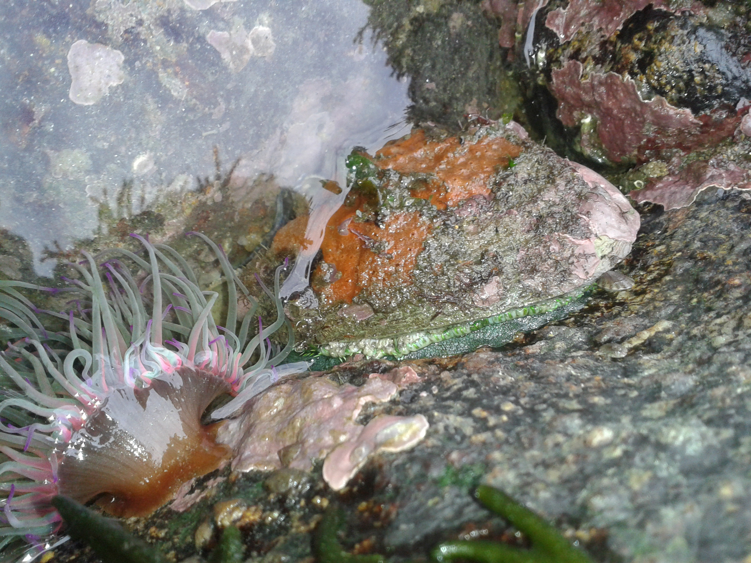
Project 3
Predicting the Age of Abalone using Machine Learning and Neural Networks
Group NoFloods
Amit Patel
Daniah Al Bayati
Roopa Patel
Samuel Parks
Steven Lee

Slide 2

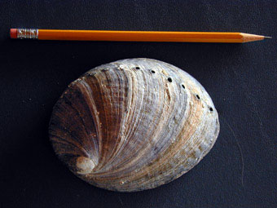
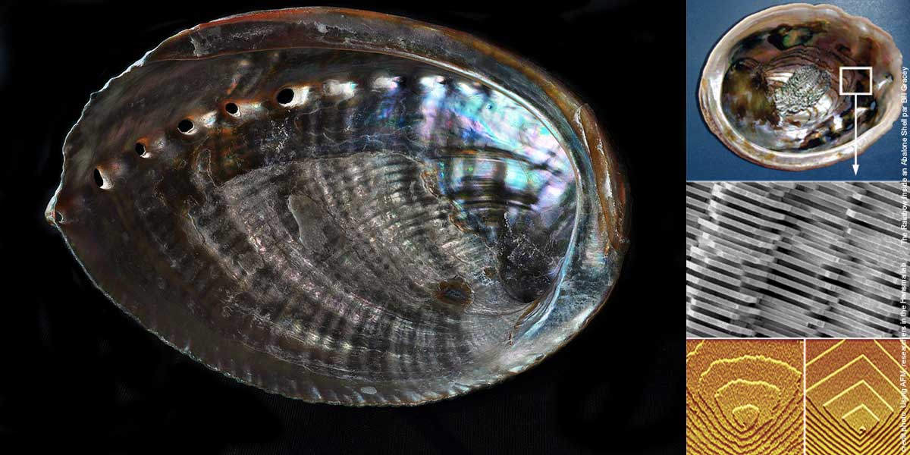
Project Goal
Predict the age of abalone using physical characteristics
Use Machine Learning and Neural Network models
vs

Slide 3
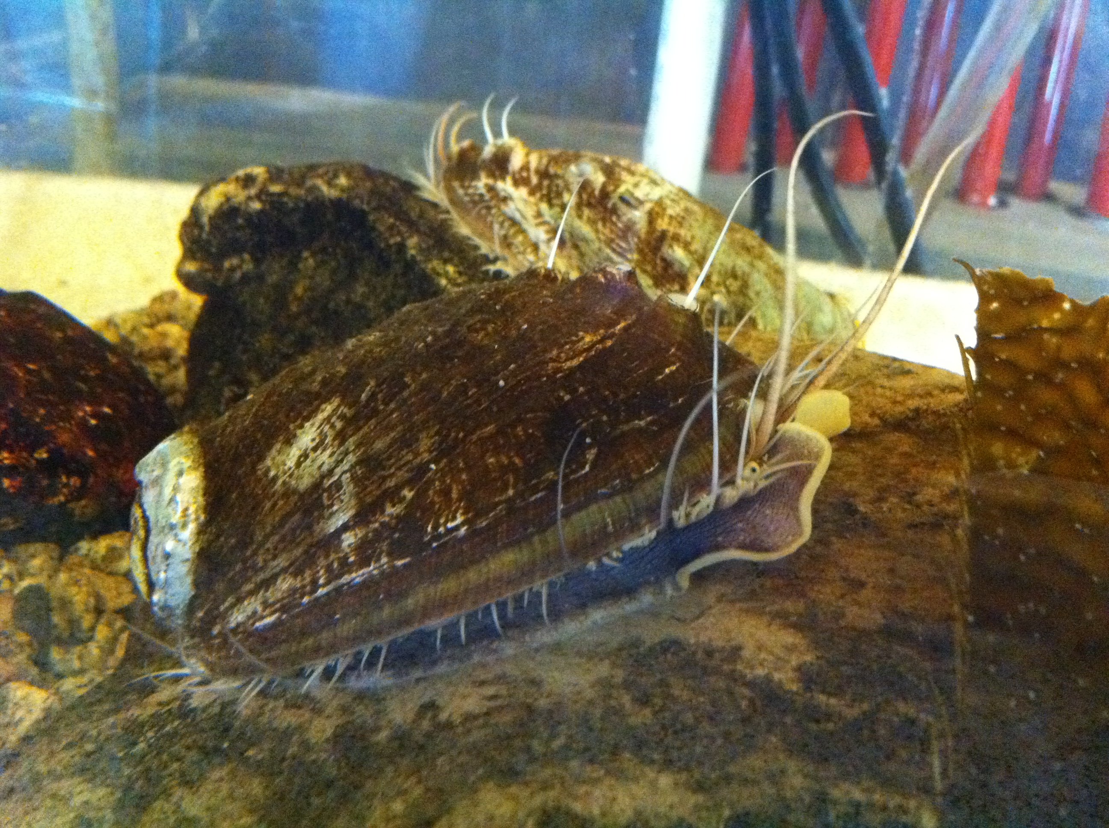
What is an abalone?
Abalone are marine snails
From Wikipedia, an abalone is a common name for any of a group of small to very large sea snails, marine gastropod molluscs in the family Haliotidae
Vary in length from 20mm – 200mm
Commonly used for food and jewelry

Slide 4
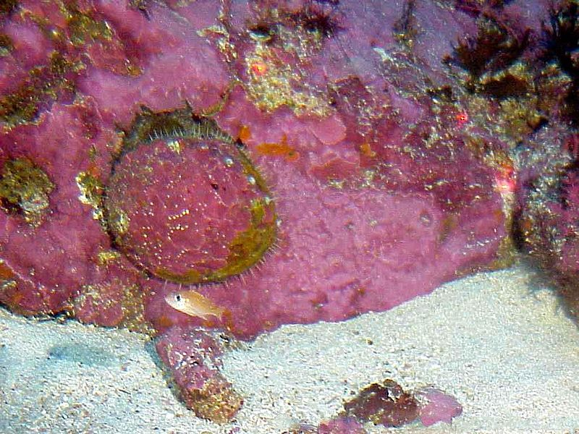
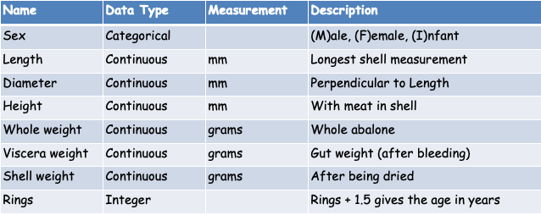
Data Source
University of California, Irvine (UCI) ML Repository https://archive.ics.uci.edu/ml/datasets/Abalone
4,177 rows with 8 attributes
Mostly continuous variables, with one categorical and one integer
For our models, we are trying to predict “Rings”
Age is directly related to Rings: Age = Rings + 1.5

Slide 5
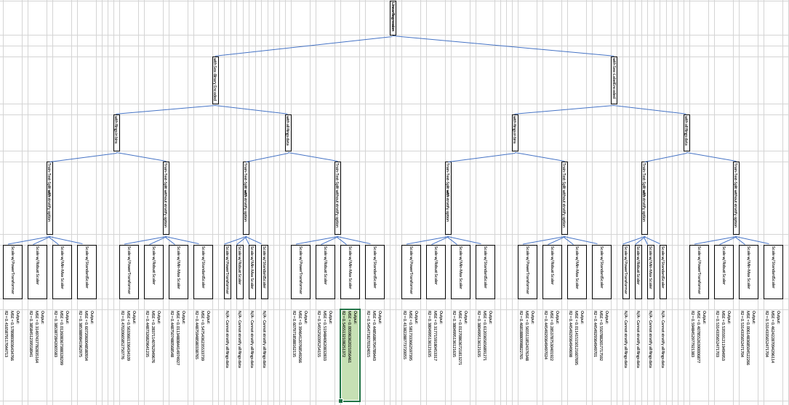
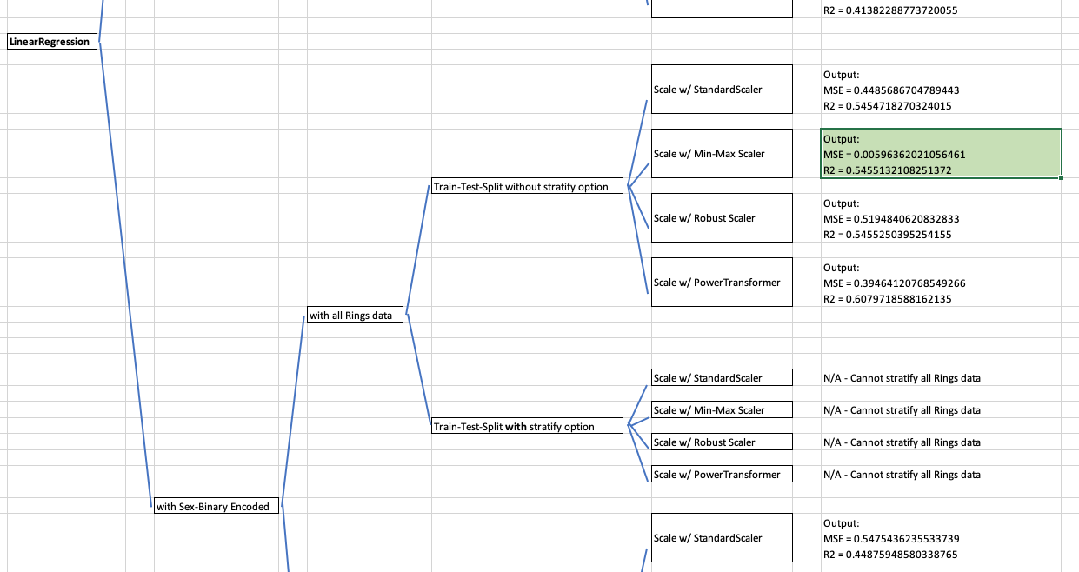
Our Methods
Data Preprocessing
ML Modeling
Linear Regression
Classification
AutoML
Neural Networks
Simple
Deep

Slide 6
Section break (Speaker change)

Slide 7
Descriptive Analytics
Slide text

Slide 8
Descriptive Analytics
Slide text

Slide 9
Descriptive Analytics
Slide text

Slide 10
Section break (Speaker change)

Slide 11
Linear Regression Models
Slide text

Slide 12
Linear Regression Models
Slide text

Slide 13
Section break (Speaker change)

Slide 14
Classification Models
Slide text

Slide 15
Classification Models
Slide text

Slide 16
Section break (Speaker change)

Slide 17
AutoML
Slide text

Slide 18
AutoML
Slide text

Slide 19
Section break (Speaker change)

Slide 20
Neural Network Models
Slide text

Slide 21
Neural Network Models
Slide text

Slide 22
Section break (Speaker change)

Slide 23
Summary
Slide text

Slide 24
Summary
Slide text

Slide 25
Next Steps
Slide text

Slide 26
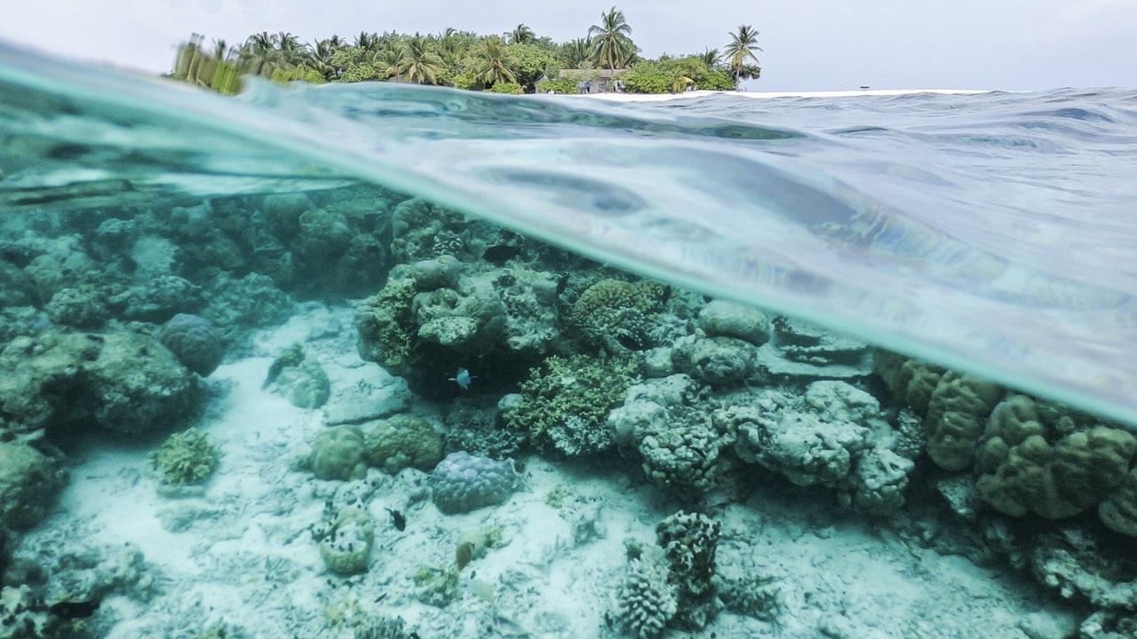
Any questions?

Slide 27
Extra blank slides below

Slide 28
Slide title
Slide text

Slide 29
Slide title
Slide text

Slide 30
Slide title
Slide text

